Slide 1

MOVE YOUR BOARD FROM TACTICAL TO STRATEGIC
Jeff Marsico
President, The Kafafian Group, Inc.
www.kafafiangroup.com

Slide 2
SESSION OBJECTIVES
2024 PACB CONVENTION
Characteristics of a strong board and a weak board
Characteristics of strong board composition
Characteristics of a good board meeting and a bad board meeting

Slide 3

ROLE OF A BANK DIRECTOR
2024 PACB CONVENTION
Select and retain competent management.
Establish, with management, the institution's long - and short-term business objectives, and adopt operating policies to achieve these objectives in a legal and sound manner.
Monitor operations to ensure that they are controlled adequately and are in compliance with laws and policies.
Oversee the institution's business performance.
Ensure that the institution helps to meet its community's credit needs.
Source: FDIC | Pocket Guide for Directors
Notes:
We should start and end every conversation on your regulator’s guidance on the role of a Director and Board, as modified by your bank.

Slide 4

ROLE OF A BANK DIRECTOR – TKG TAKE
2024 PACB CONVENTION
Select the CEO. Includes succession. May select or approve of CEO selection of management.
Approve the Bank’s strategy.
Approve and monitor the Bank’s risk appetite.
Monitor the Bank’s operations and controls.
Engage with the community.
Manage the board itself.
Notes:
Here is our take on the role of a Director that recognizes more than safety and soundness, although it is certainly central to bank board responsibilities.

Slide 5
TYPES OF BOARD MEMBERS
2024 PACB CONVENTION
Micromanagers
Negative Impact
Neutral No Impact
Monitoring & Checklist
Forgot they hired a management team
Believe they must be involved in day-to-day
Believe they must make every decision or at minimum be involved in every decision
Often have trouble attracting quality management
Sometimes have conflicts of interest
What micromanagers can become
May panic in a crisis
Do not come to the meetings prepared
Have not thought about the Bank since the last meeting
Have a history of making bad decisions
Often have unfocused, endless meetings
Tend to be negative versus positive thinkers
Don’t have negative or positive impact on Board decisions
Often prestige drives the desire to remain on the Board
Don’t like to make waves or ask questions
Allow management/CEO to be dominant
Sometimes a friend of the CEO
Can be “Rubber Stamp” or comfortable with the status quo
Strictly follow policies and procedures
Have a basic understanding of governance and fiduciary responsibility
Contributions stop short of providing a real competitive advantage
Tend to have a positive but limited impact
“Just don’t get me in trouble” attitude
Can turn into Micromanagers if not careful
Notes:
Micromanaging board: might often have an exec committee that must be consulted often between meetings. Negative Impact: Don’t ask the right questions and lead down rabbit holes of inconsequential topics. Neutral boards I would argue gravitate to negative impact if they allow CEO to dominate board-level decision making. Monitoring & checklist boards lead to endless agenda check-boxing.

Slide 6

BOARD AGENDA
2024 PACB CONVENTION
Monitoring & Checklist Board
Prior Meeting Minutes
New Loans
President’s Report
Officer Promotions
Corporate Scorecard
Business Loans
Reg-O Loans
Loan Committee Minutes
Non-accrual Loans
Proposed Charge-offs
OREO Summary
Commercial Risk Summary
Policy Updates
Exceptions
Deposit Referrals
Investment Purchases & Sales
Investment Policy Review
Financial Reports
Financial Audit Reports
Contingent Liquidity Plan
Capital Plan
FRB Liquidity Facility
Outstanding Audit & Exam Action Items
SAR Filings
BSA/OFAC Risk Assessment
Information Security Update
Notes:
This board asked us to propose something different because meetings were so long and it wore them out. Board packages were >500 pages.

Slide 7

TYPES OF BOARD MEMBERS
2024 PACB CONVENTION
Strategic Asset – Performance Enhancer
Understand their governance, oversight, and fiduciary responsibility role
Continually educate themselves
Hold themselves accountable for executing their governance responsibilities
Understand and identify internal and external factors affecting the Bank and Board performance
Know the balance between disagreeing and being disagreeable
Demand good information to make informed decisions
Understand risk factors
Ask the right questions and probe for answers
Set strategic direction for the Bank
Empower management to oversee the execution of strategy and oversee the day-to-day and longer-term operations
Provide proper incentives
Hold management accountable for results with limited benchmarks
Become ambassadors for the Bank in the communities it serves and throughout the industry
Notes:
The key is to move every member to be a strategic asset and this first starts with interview, orientation, and education.

Slide 8
BOARD AGENDA
2024 PACB CONVENTION
Strategic Asset – Performance Enhancer
Board Education, Strategy Update, Industry Update, etc.
Consent Agenda:
  Minutes Approvals
  Reports:
    Loans Closed
    Investment Portfolio by Maturity & Type
    Subsidiary financials
    Commercial Concentrations
Management Reports:
  CEO: Current situation analysis, overall bank financial performance and condition
  CFO: Monthly financial reports and variance to budget, Allowance Report, Liquidity Report, Interest Rate Risk, Investment Activity
  Chief Risk Officer: BSA Final Exam Report, Audit Exception Update, SARs
  Chief Loan Officer: Loan Review Policy, Appraisal Policy, Non-performing Loan/ Charge-offs Summary Report, Loan Exception Report
Other Matters
  Other business/ correspondence/ announcements
  Management take-away’s/to-do’s
  Adjourn bank board meeting
Executive Session
Notes:
These board meetings were not as long, and not packed with agenda items so directors clammed up so as not to impede progress. Sample would be when an ALCO committee chair commented that their FHLB borrowing capacity decreased by 1/3 because of the condition of the collateral files. A non-ALCO board member challenged the why, and discussion ensued on prioritizing what had to be done to restore it.

Slide 9
BOARD COMPOSITION
2024 PACB CONVENTION
Query: Is there a causal relationship between board diversity and financial performance?
“It's important to note that while research suggests a positive correlation (not causation), it's not always consistent. Some studies have found no significant relationship, while others have even shown a negative correlation. The relationship can be influenced by a variety of factors, and it's likely that the impact of board diversity on financial performance varies across different industries, companies, and contexts.”
Points For Diversity:
Diverse perspectives
Enhanced innovation & business opportunities
Improved risk management
Enhanced reputation
Points Against Diversity:
Correlation vs. Causation
Tokenism and Divisive
Lack of Expertise
Unintended Consequences (increased legal risk, conflict unrelated to company performance, difficulty getting to consensus)
Source: Google Gemini https://gemini.google.com/app/114af1f31605456d
Notes:
Was a hot-topic. There is push back because it started to amount to nothing more than checking boxes imposed on us by outsiders. It should be checking boxes. But imposed by us.

Slide 10
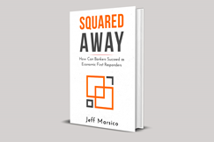
BOARD COMPOSITION
2024 PACB CONVENTION
From: Squared Away-How Can Bankers Succeed as Economic First Responders
Chapter 3: What Makes an Effective Community Banking Board
Research does not indicate an obvious correlation between financial performance and the professions, ages, or number of board members.
When making decisions on board composition, look to board responsibilities as defined by your regulator and bank.
Think of your board as a single body. If you need an arm, get an arm. Don’t get another leg.
Groupthink is a board’s worst enemy. Board diversity matters most to avoid groupthink.
Age limits are a mistake. Consider term limits to reduce the possibility of over-familiarity and groupthink. Such as 10-15 years.
Perform board assessments regularly and consider using an outside firm since self-assessments are so difficult.
Board size should be 7-11 members. Limit insiders to one or no more than two to avoid factions. If you have two, consider the larger board size.
Develop and execute a disciplined nominating process so you don’t have all buddies on the board.
Source: Squared Away-How Can Bankers Succeed as Economic First Responders Amazon.com: Squared Away: How Can Bankers Succeed as Economic First Responders: 9780982693827: Marsico, Jeffrey: Books
Notes:
Compared top 5 to bottom 5 ROE banks, then top 5 and bottom five total return banks.

Slide 11
BOARD COMPOSITION
2024 PACB CONVENTION
Common Sense
Suggested Board Members From:
Legal profession
Accounting profession
Former banker(s) (other than CEO on the board). Caveat: There is risk to having former CEO on board.
Technology
And then…
From these industries?
From this demographic?
Source: Census.gov
Notes:
If you determine you need a CPA and your process is “hey does anyone know an accountant”, you are at a higher risk of groupthink because you are more likely to bring buddies onboard.

Slide 12
BOARD COMMUNICATION
2024 PACB CONVENTION
Board Chair
Committee Chairs
Committee Members
Full Board
CEO
Management
Noses in, fingers out
Limit meetings after the meeting
Bring multiple management team members to board meetings to improve familiarity, give visibility, promote leadership development, and encourage robust discussion
Board chair and committee chair direct discussions with management should be for risk mitigation and to ensure information flows to the board are accurate (such as ALCO chair speaking with CFO about ALCO consultant’s report). If a committee member has a question, go through committee chair (i.e. board member asking Governance/ Nominating Committee chair about Board Education).
Otherwise, direct discussions should be limited so as not to distract management from running the bank in a safe and sound manner and executing strategy.
Board members can also directly communicate with management for business development/ community engagement activities.
Notes:
Spoke to a CEO who said she gets board members calling her daily for various and assundry reasons, many of those calls requires follow-on resource demands.

Slide 13

BOARD COMMITTEES
2024 PACB CONVENTION
Committees are formed either to provide ongoing oversight in specific areas of the Bank, or to address a specific, ad-hoc issue.
The overall Board delegates responsibility and authority to the committee.
A board cannot afford to have “make work” committees.
Need to focus on the purpose of a committee (should be in committee charter):
  What will be the value of the committee to the overall Board?
  What specific issues/concerns will the committee address?
Recognizes the need for specialized skills and knowledge.
Requirements for committee leadership.
Plans for on-going turn-over in the membership and leadership of the committee.
Establish requirements for reporting to the overall Board (through minutes and report summaries).
Finally, periodically review the on-going need for the committee.
Notes:
Ref the ALCO chair comment as one where an important safety/soundness issue should have been uncovered/debated in committee and then to the full board.

Slide 14
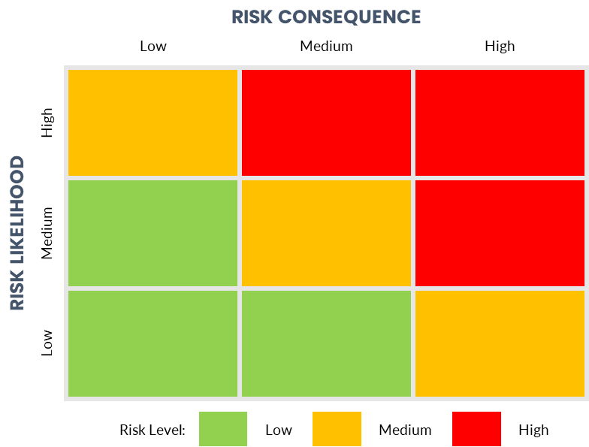
BOARD RESPONSIBILITIES
2024 PACB CONVENTION
Approve and Monitor Adherence to Policy & Bank’s Risk Appetite
 | RISK DESCRIPTION | RISK MITIGATION PLAN | RISK LEVEL/ TREND
1 | Credit Risk | Adhere to loan policy. NPL/Loans < Peer median. Investment portfolio remain investment grade. <10% Corporates | Low Likelihood High Consequence Three months negative trend
2 | Liquidity Risk | Cash and due 3%-5% of Assets. Investment portfolio >65% Treasuries/agencies. Liquidity ratio >11% | Low Likelihood Medium Consequence Two months positive trend
3 | Operations Risk | No high severity vulnerabilities in pen testing. No repeat vulnerabilities. Operations losses <1% of pre-tax profit. | Medium Likelihood Medium Consequence Check fraud 5 months negative trend.
Notes:
Every bank should have a risk appetite statement that gives the risk guardrails the bank is willing to take in the execution of strategy. Leading and lagging indicators, Trends,

Slide 15
BOARD EDUCATION
2024 PACB CONVENTION
Board education should be intentional
Based on recommendations by board members and the management team
Managed by the Governance and Nominating Committee
Include the budget that is managed by Committee Chair to allow flexibility in changing schedules and needs
Focused on preparing board members to execute their responsibilities
Conference attendance could be used as a reward for things like “most referrals”. Attending board member could brief full board on takeaways.
Notes:
Navy example. Managed in governance. Could leverage bank employee training modules and be maintained in HR, but managed in Governance Cmte.

Slide 16




BOARD: STRATEGIC ASSET
2024 PACB CONVENTION
Agenda Item: Board Education, Strategy Update, Industry Update
Board
Education
On Economy & Banking
Notes:
Strategy: Treat changes to strategy like changes to policy. If material, seek board approval. Otherwise this is “where are we to strategy” session. Update: Could be done by high potential internal person or external consultant. Board education: also can be substituted for board recognition of employees who have done something exemplary. Board members tend to like this part of agenda.

Slide 17

BOARD: STRATEGIC ASSET
2024 PACB CONVENTION
Agenda Item: Executive Session
What did we learn?
What was the most positive?
What was the most concerning?
What are we hearing from shareholders, customers, employees or community members?
What are management’s takeaways or to-do’s from this meeting?
Are there board and/ or board committee takeaways or to-do’s?
CEO Performance (done in Governance/Nominating) and/ or Compensation (annually)
Executive incentive plans (annually)
Notes:
Always on the agenda to remove stigma. Can include the CEO except for performance/compensation so long as CEO is not controlling

Slide 18
KEY TAKEAWAYS
2024 PACB CONVENTION
Define your own Strategic Asset – Performance Enhancing Board
Diagnose what makes your board tactical to attack the symptoms
Design board selection, education, agendas, and governance to bridge the gap from where you are to where you want to be
Wherever you want to be, ensure it is efficient and effective in executing board responsibilities

Slide 19
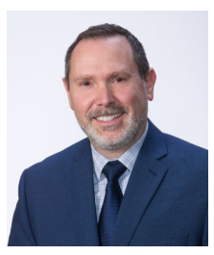
ABOUT THE PRESENTER
2024 PACB CONVENTION
JEFFREY P. MARSICO
JMARSICO@KAFAFIANGROUP.COM
973.299.0300 X120
www.kafafiangroup.com
www.jeff4banks.com
Mr. Marsico is the President, shareholder, and founding member of TKG. His specialties include: facilitating the development of client strategies; mergers & acquisitions; profit/process improvement consulting engagements; profitability consulting; and regulatory order assistance.
As part of the strategic consulting team, Mr. Marsico has analyzed and facilitated hundreds of strategy development engagements for community financial institutions resulting in documented strategic plans to guide client employees and improve performance. He has negotiated, analyzed, and advised Boards of Directors regarding bank mergers and acquisitions resulting in whole institution and branch sale transactions with values in excess of $2B, including the first reverse merger-conversion where the converting thrift acquired a commercial bank.
Mr. Marsico began his banking career in 1985 and his experience includes: IT and Trust operations with Northeastern Bank of Pennsylvania (now PNC Financial Services Group, Inc.); retail branch management and strategic planning with First Maryland Bancorp (now M&T Bank Corporation); and financial institution mergers & acquisitions, consulting, and capital formation with Tucker Anthony Sutro Capital Markets (now RBC Capital Markets). He interrupted his banking career and served seven years as a Military Intelligence Analyst in the United States Navy, earning three Navy Achievement Medals, the Kuwait Liberation Medal, the Southwest Asia Service Medal, the Combat Action Ribbon, Sea Service Ribbon, and other various commendations.
Mr. Marsico is the author of Squared Away-How Can Bankers Succeed as Economic First Responders and serves on the faculty of various state banking associations’ Executive Development Programs. He is frequently sought out by industry publications regarding the changes occurring in financial services and is a noted industry commentator via his blog.

